Slide 1
Introduction into JavaScript JavaScript & Browser
November 24, 2014

Slide 2

Agenda
window object
DOM API

Slide 3
window object
Global window variable
Provides browser API (BOM – Browser Object Model)
Contains objects created by browser
alert(typeof window); // object
alert("alert" in window); // true
alert("setTimeout" in window); // true
alert("window" in window); // true
alert("document" in window); // true
window.alert("Hello!");

Slide 4
window object
Any global variable is a field of window object:
var a = "Hello";
alert(a); // Hello
alert(window.a); // Hello
function foo() {
var b = "World";
alert(b); // World
alert(window.b); // Undefined
}
foo();

Slide 5
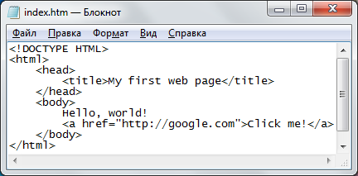
DOM – Document Object Model
.html file
DOM
document
<html>
<head>
<body>
<title>
Hello, world!
<a>
href
Document loading
My first web page
Click me!

Slide 6
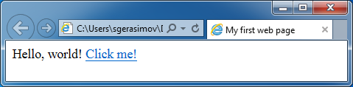
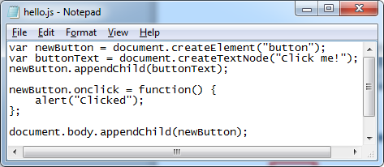
DOM – Document Object Model
Browser
JavaScript
DOM
document
Renders
Handles events
<html>
<head>
<body>
<title>
Hello, world!
<a>
href
Raises events
Modifies
My first web page
Click me!

Slide 7
document object
Global window.document variable
Methods to find, modify and create elements
Root nodes:
// <html>...</html>
alert(document.documentNode.outerHTML);
// <body>...</body>
alert(document.body.outerHTML);

Slide 8
document object
<button id="myUniqueID" class="but active">
Click me!
</button>
Find elements:
document.getElementById(id)
document.getElementsByTagName(tagName)
document.getElementsByClassName(className)

Slide 9
HtmlElement object
var x = document.getElementById("x");
x instanceof Object; // true
x instanceof EventTarget; // true
x instanceof Node; // true
x instanceof Element; // true
x instanceof HTMLElement; // true

Slide 10
document object
Find all links at the page:
var links = document.getElementsByTagName("a");
for (var i = 0; i < links.length; i++) {
alert(links[i].outerHTML);
}

Slide 11
Node relationships
// <div id="x">
// <a>Link</a>
// <button id="y">Button</button>
// <p>Text</p>
// </div>
var x = document.getElementById("x");
alert(x.firstChild.outerHTML);
alert(x.lastChild.outerHTML); alert(x.childNodes[1].outerHTML);

Slide 12
Node relationships
// <div id="x">
// <a>Link</a>
// <button id="y">Button</button>
// <p>Text</p>
// </div>
var y = document.getElementById("y");
alert(y.parentNode.outerHTML);
alert(y.previousSibling.outerHTML);
alert(y.nextSibling.outerHTML);

Slide 13
Node properties
// <a id="x" href="http://google.com">
// <span>Go</span>
// </a>
var x = document.getElementById("x");
alert(x.outerHTML); // <a id="x" href="...">...</a>
alert(x.innerHTML); // <span>Go</span>
alert(x.textContent); // Go
alert(x.nodeName); // a

Slide 14
Node properties
// <a id="x" href="http://google.com">Go</a>
var x = document.getElementById("x");
for (var i = 0; i < x.attributes.length; i++) {
var attribute = x.attributes[i];
alert(attribute.nodeName);
alert(attribute.value);
}
alert(x.href); // http://google.com
x.href = "http://yandex.ru";

Slide 15
Events
// <a id="x" href="http://google.com">Go</a>
var x = document.getElementById("x");
// Event handler
x.onclick = function () {
alert("Clicked the link");
return false; // prevent default action
};

Slide 16
Events
// <a id="x" href="http://google.com">Go</a>
var x = document.getElementById("x");
// Modern browser
x.addEventListener("click", function () {
alert("Clicked the link");
});
// browser <= IE 8
x.attachEvent("onclick", function () {
alert("Clicked the link");
});

Slide 17
DOM modification
HTML replacement:
node.innerHTML = "<div>New content</div>";
Element creation:
document.createElement(tagName)
document.createTextNode(text)
Adding element to the page:
node.appendChild(otherNode)
node.insertBefore(newNode, oldNode)
node.replaceChild(newNode, oldNode)
Element removal:
node.removeChild(childNode)

Slide 18
DOM modification
// <a id="x" href="http://google.com">Go</a>
var x = document.getElementById("x");
x.innerHTML = "<div>New content</div>";
// <a id="x" href="http://google.com">
// <div>New content</div>
// </a>

Slide 19
DOM modification
// <div id="placeholder"></div>
var newButton = document.createElement("button");
var buttonText = document.createTextNode("Click!");
newButton.appendChild(buttonText);
var placeholder =
document.getElementById("placeholder");
placeholder.appendChild(newButton);
// <div id="placeholder">
// <button>Click!</button>
// </div>

Slide 20
Waiting for DOM to load
window.onload = function() {
// DOM is ready
// every external resource is loaded
// images, scripts and styles are loaded
...
};
document.addEventListener("DOMContentLoaded", function() {
// DOM is loaded
// scripts are loaded
...
});

Slide 21
Links
JavaScript:
https://developer.mozilla.org/en-US/docs/Web/JavaScript
https://developer.mozilla.org/en-US/docs/Web/JavaScript/Reference
http://www.w3schools.com/js/default.asp
http://msdn.microsoft.com/ru-RU/library/d1et7k7c.aspx
http://learn.javascript.ru/
http://dmitrysoshnikov.com/ecmascript/ru-javascript-the-core/
DOM:
http://www.w3schools.com/js/js_htmldom.asp
http://www.w3schools.com/jsref/dom_obj_document.asp
https://developer.mozilla.org/en-US/docs/DOM
HTML:
http://www.w3schools.com/html/default.asp
http://htmlbook.ru/samhtml
CSS:
http://www.w3schools.com/css/default.asp

